Slide 1

RUNGTA COLLEGE OF DENTAL SCIENCES & RESEARCH
TITLE OF THE TOPIC
BACTERIAL INFEACTIONS OF ORAL CAVITY
DEPARTMENT OF ORAL PATHOLOGY & MICROBIOLOGY

Slide 2
BACTERIAL INFECTIONS OF ORAL CAVITY
GUIDED BY –
DR. SIDDHARTH PUNDIR DR. SUDHANSHU DIXIT

Slide 3
Specific learning Objectives
CORE AREAS* | Domain ** | Category #
LEPROSY ACTINONYCOSIS SYPHILLIS GONORRHOEA TUBERCULOSIS CAT-SCRATCH DISEASE SCARLET FEVER TETANUS NOMA | COGNITIVE COGNITIVE COGNITIVE COGNITIVE COGNITIVE COGNITIVE COGNITIVE COGNITIVE COGNITIVE COGNITIVE | MUST KNOW MUST KNOW MUST KNOW MUST KNOW MUST KNOW MUST KNOW MUST KNOW MUST KNOW MUST KNOW MUST KNOW

Slide 4
Table of Content
LEPROSY
ACTINONYCOSIS
SYPHILLIS
GONORRHOEA
TUBERCULOSIS
CAT-SCRATCH DISEASE
SCARLET FEVER
TETANUS
NOMA

Slide 5
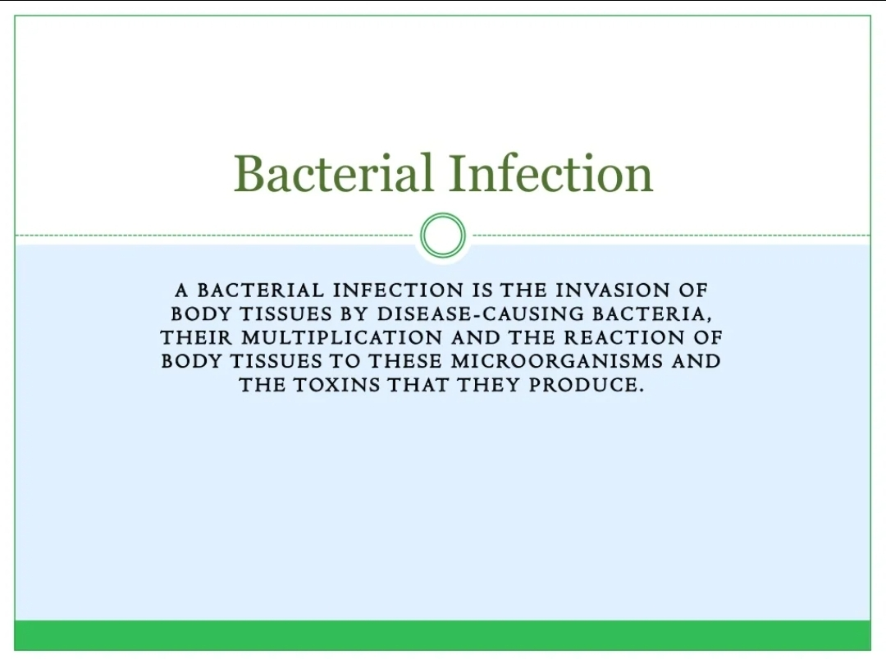

Slide 6
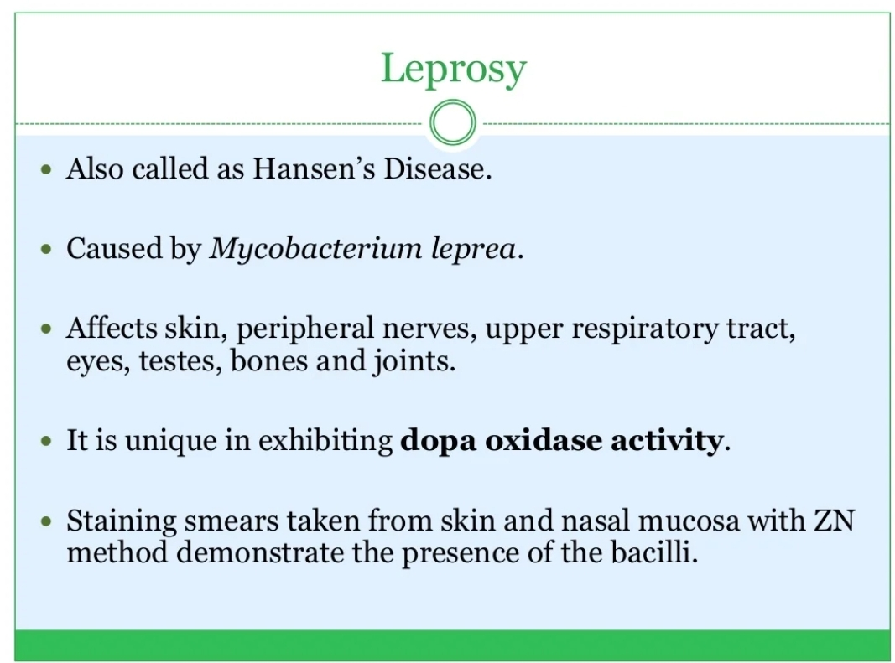

Slide 7
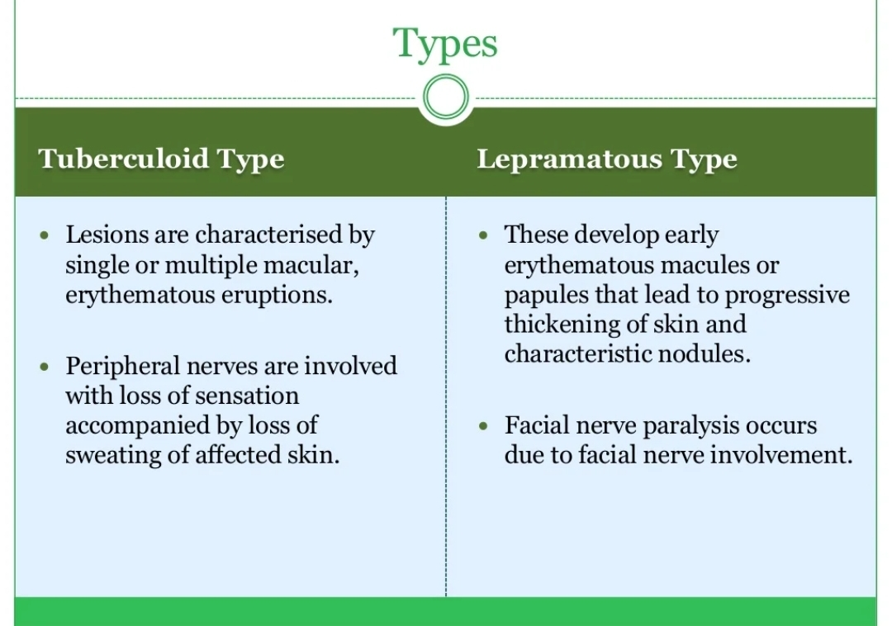

Slide 8
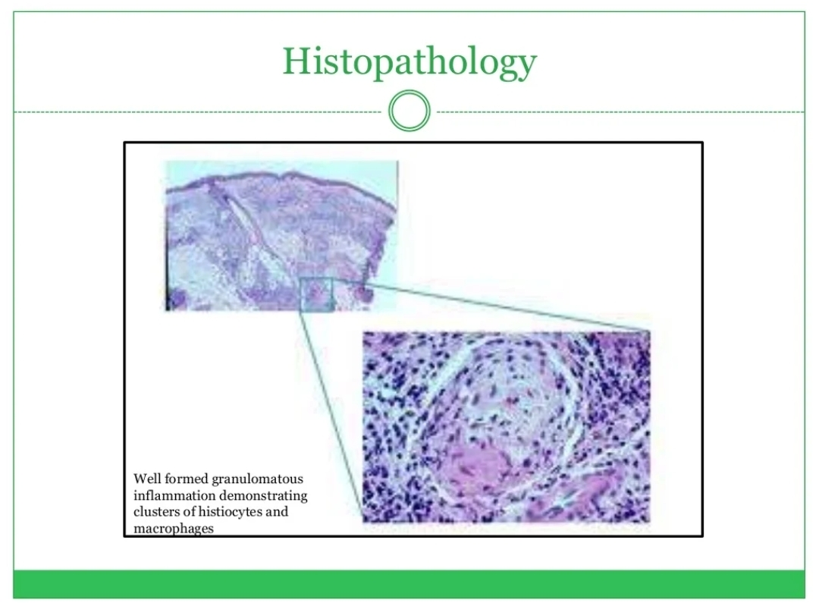

Slide 9
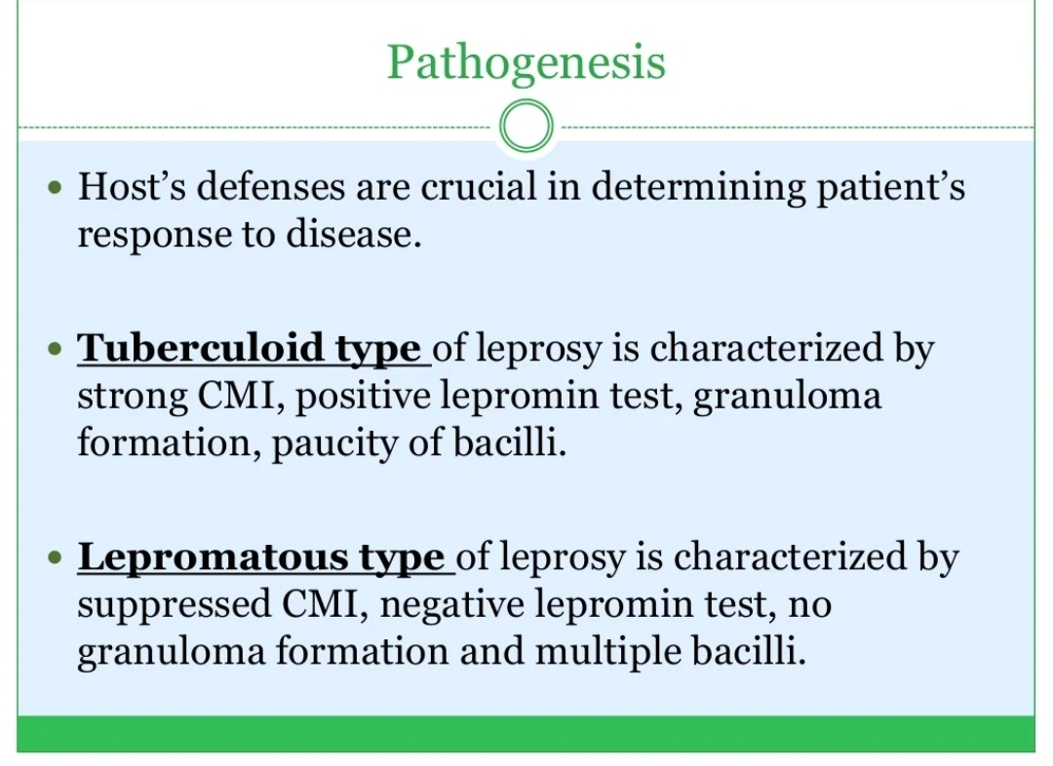

Slide 10
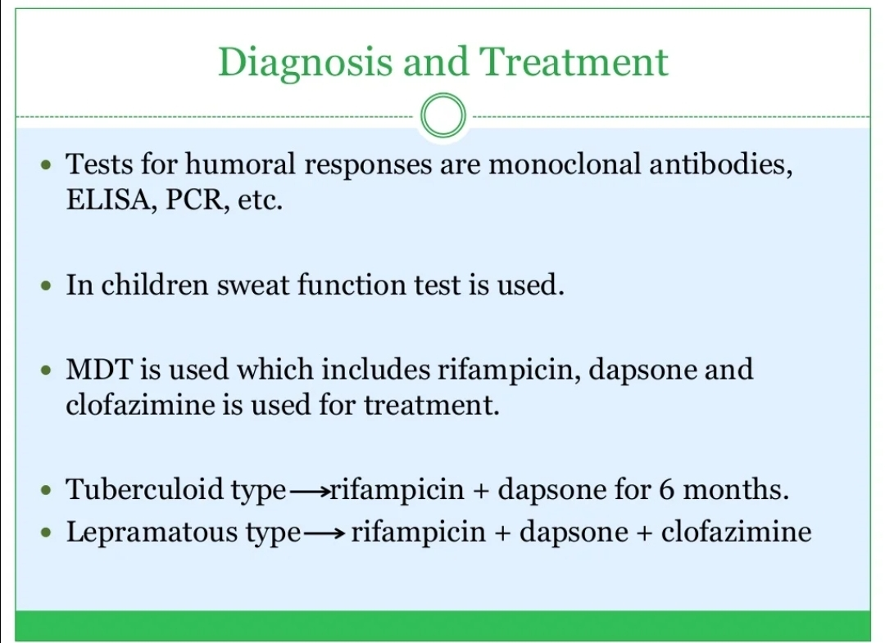

Slide 11
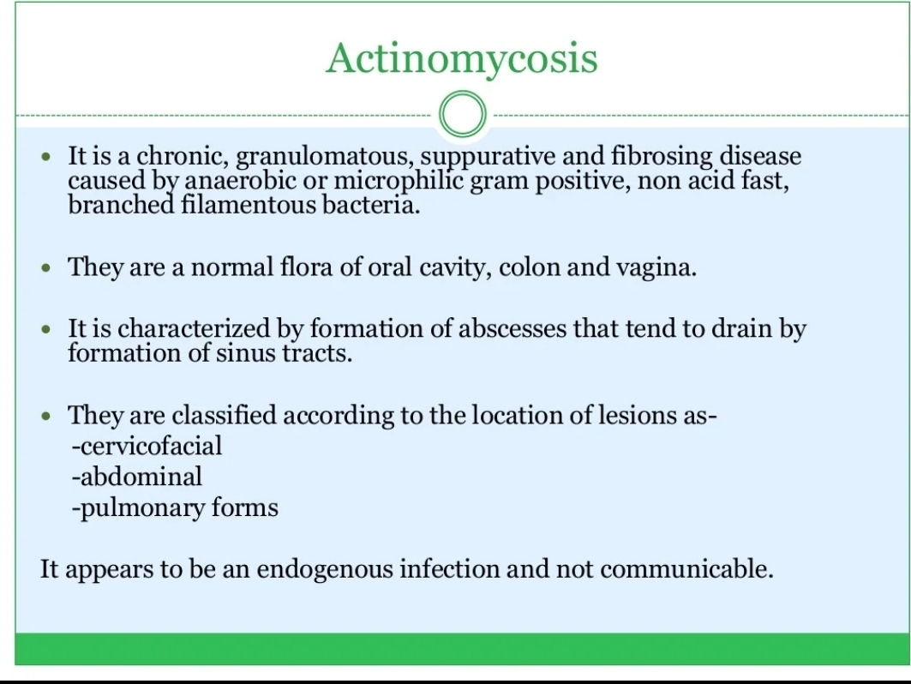

Slide 12
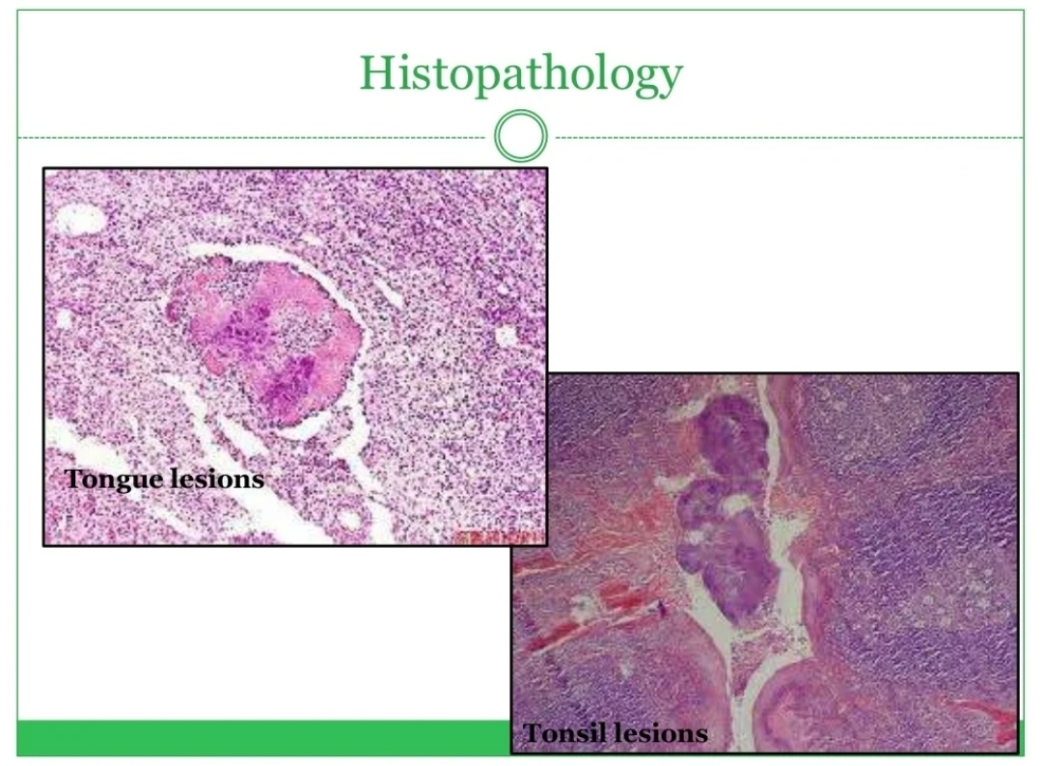

Slide 13
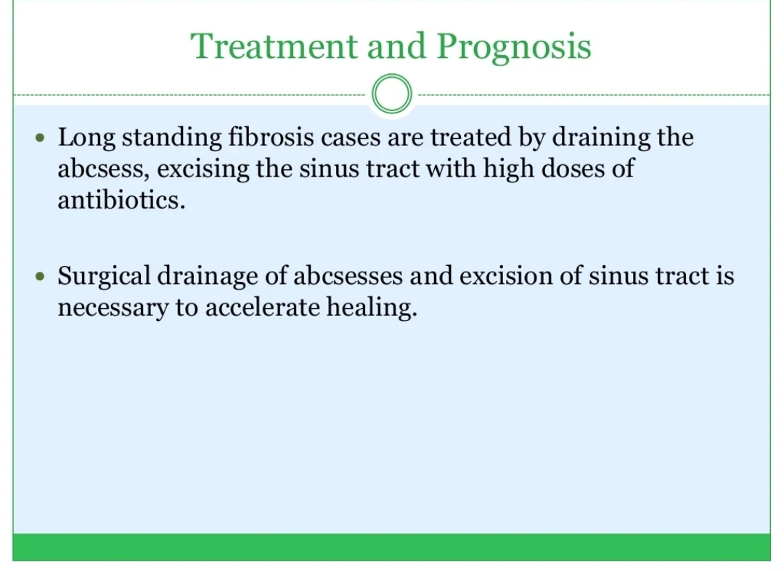

Slide 14
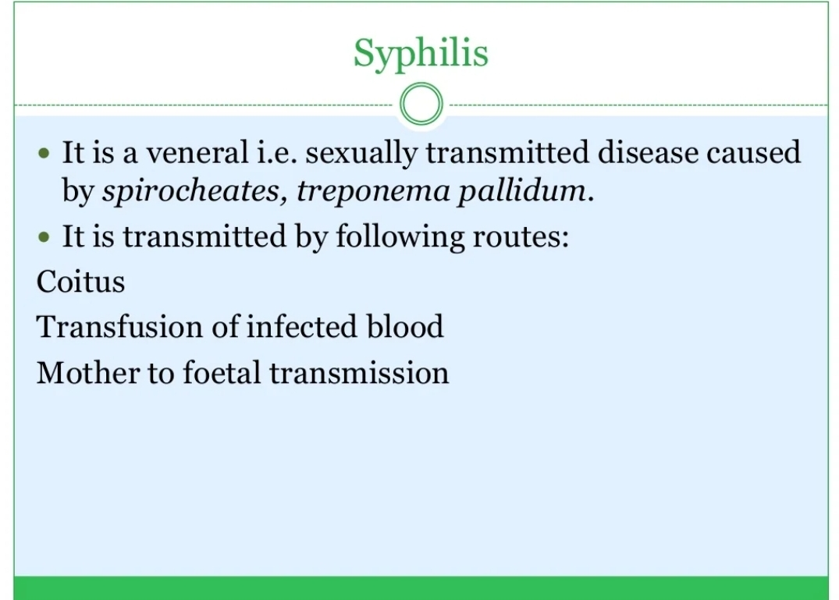

Slide 15
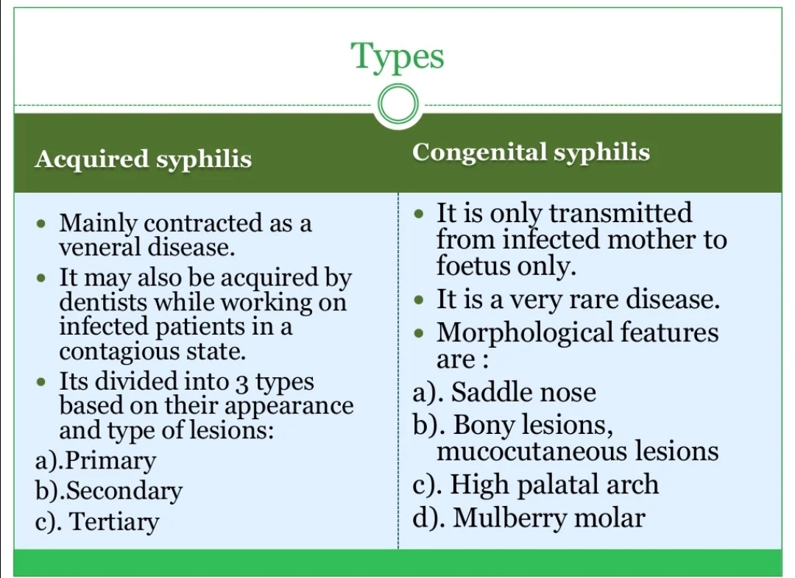

Slide 16
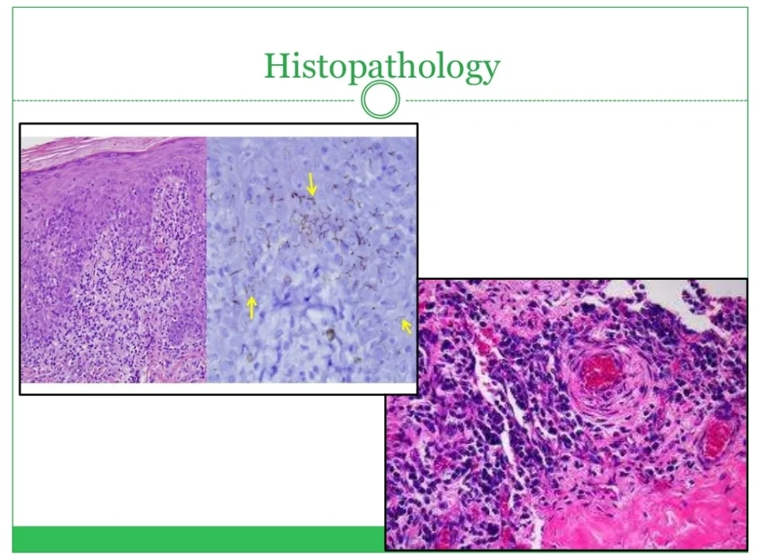

Slide 17
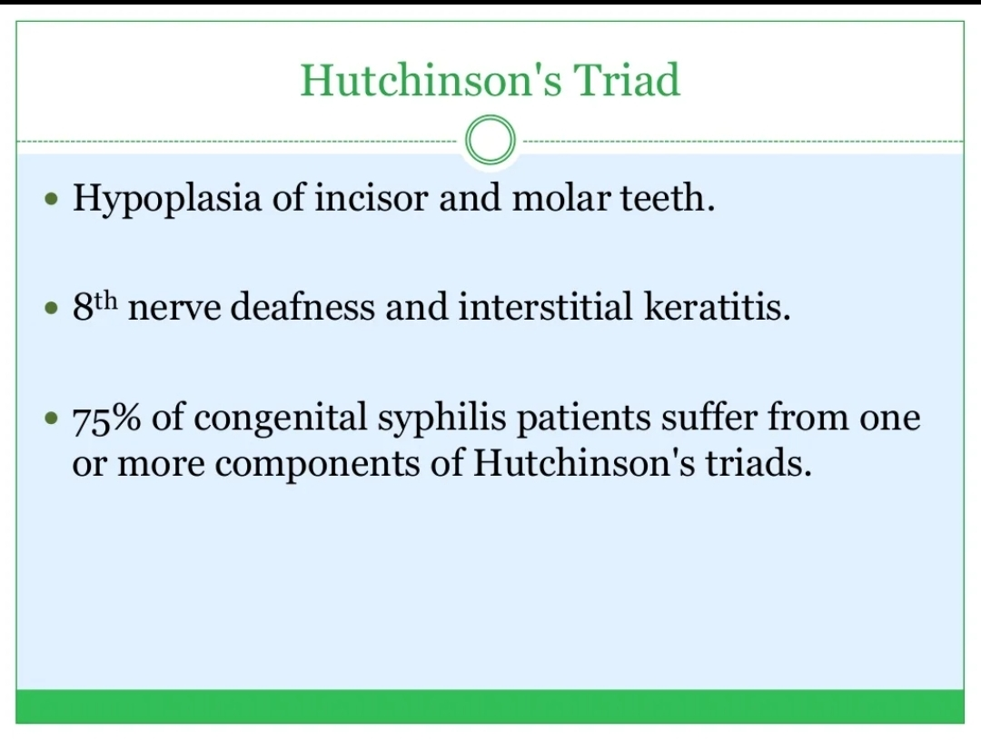

Slide 18
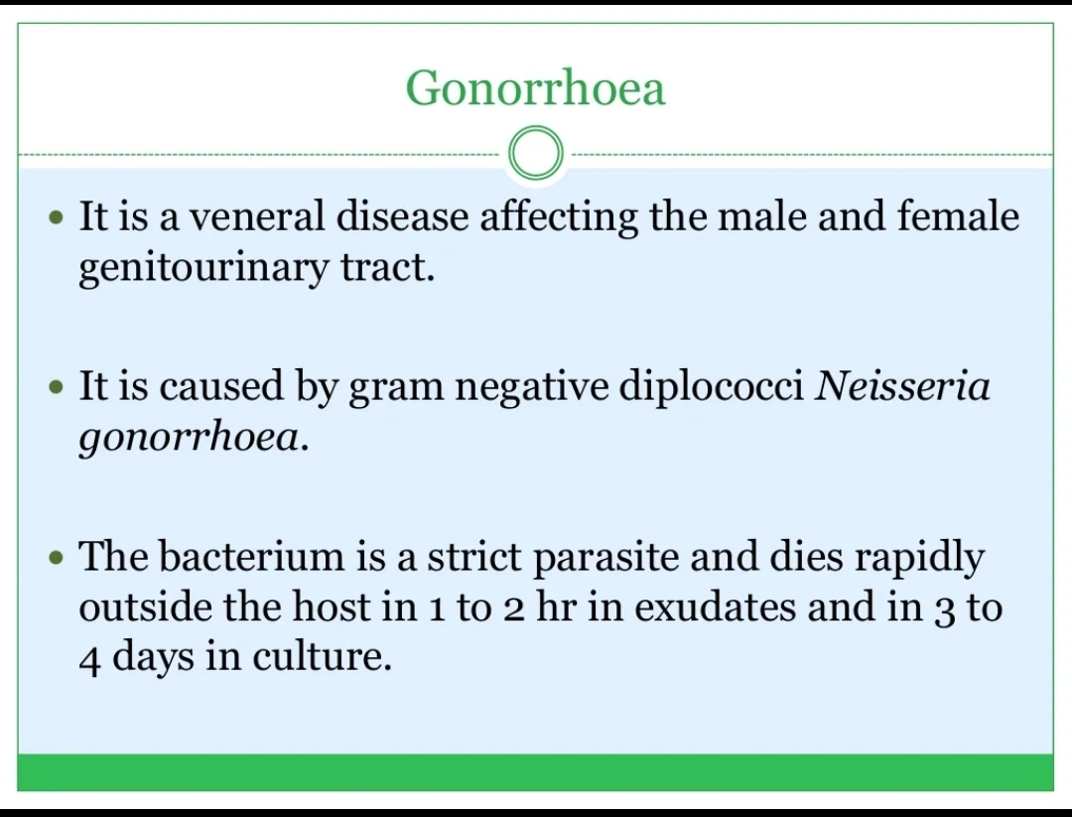

Slide 19
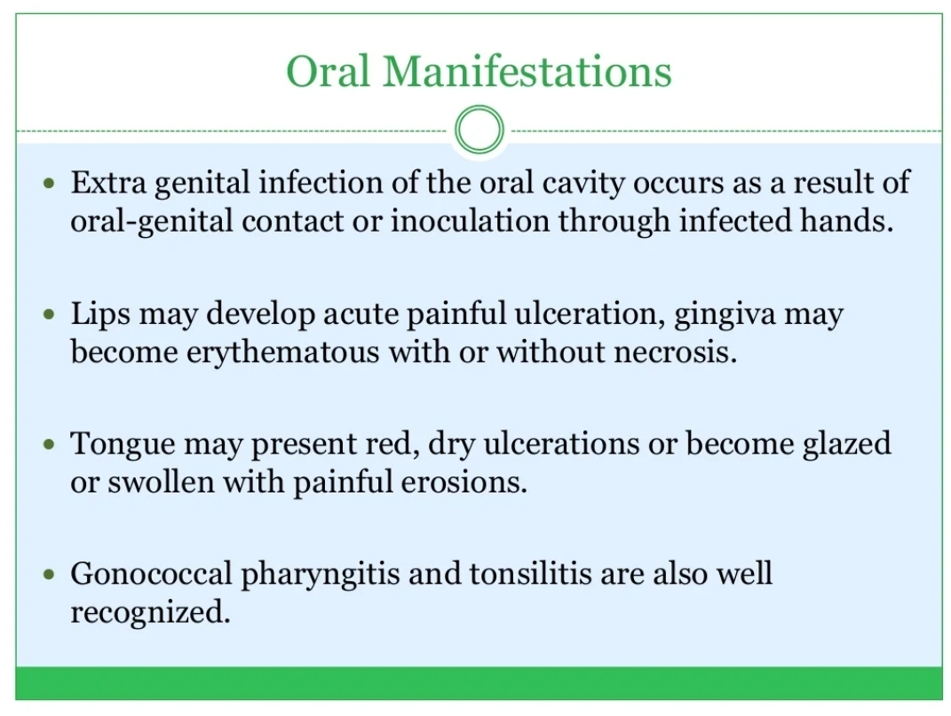

Slide 20
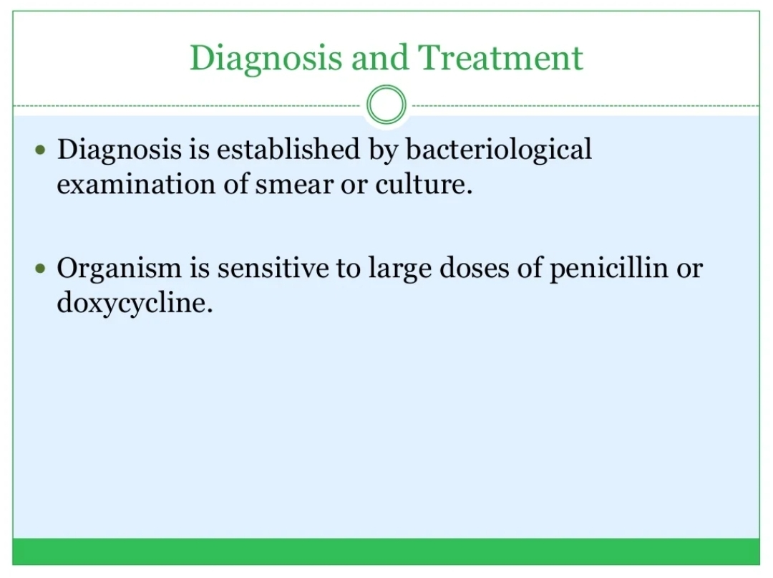

Slide 21
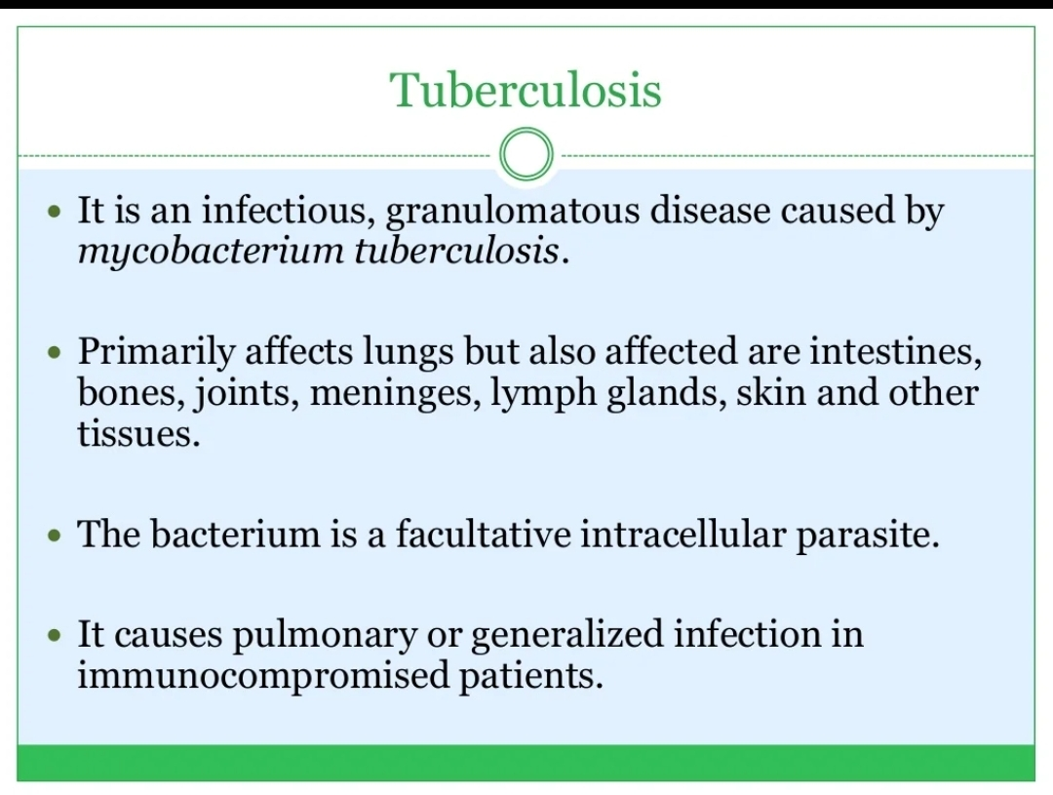

Slide 22
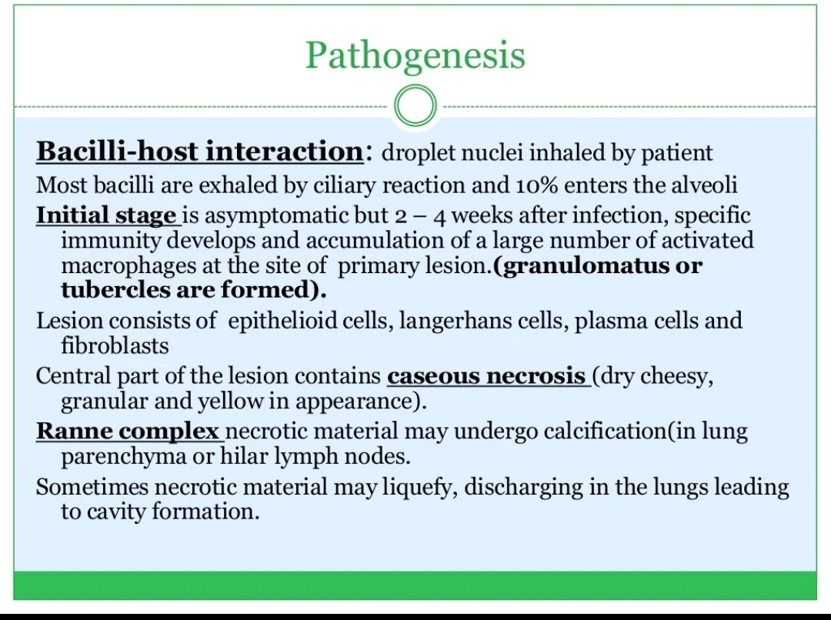

Slide 23
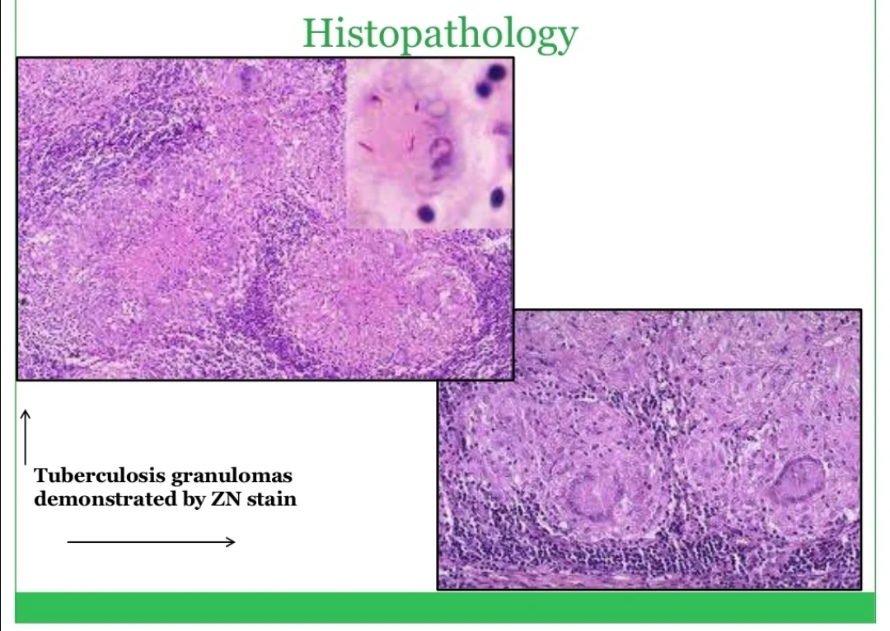

Slide 24
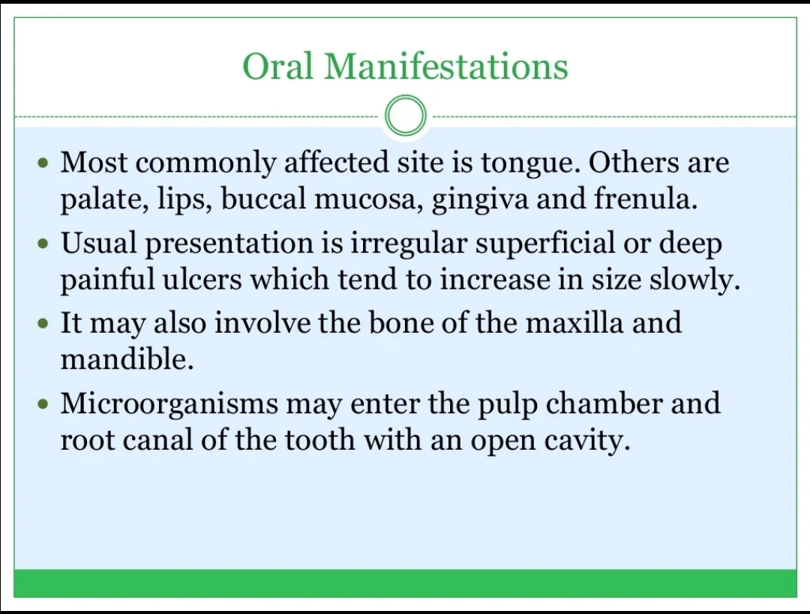

Slide 25
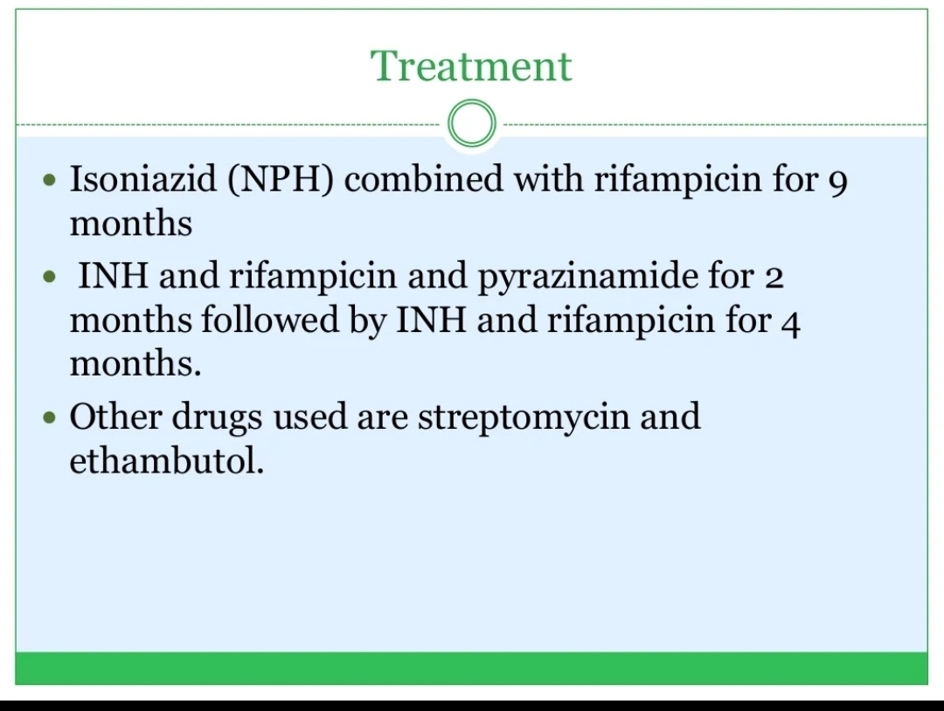

Slide 26
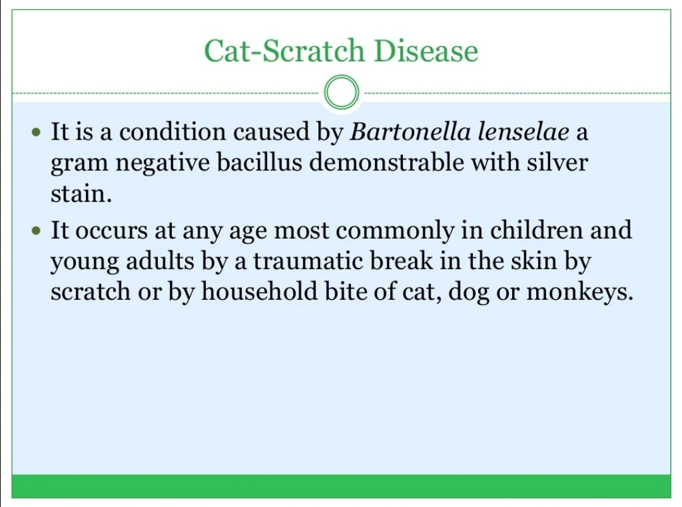

Slide 27
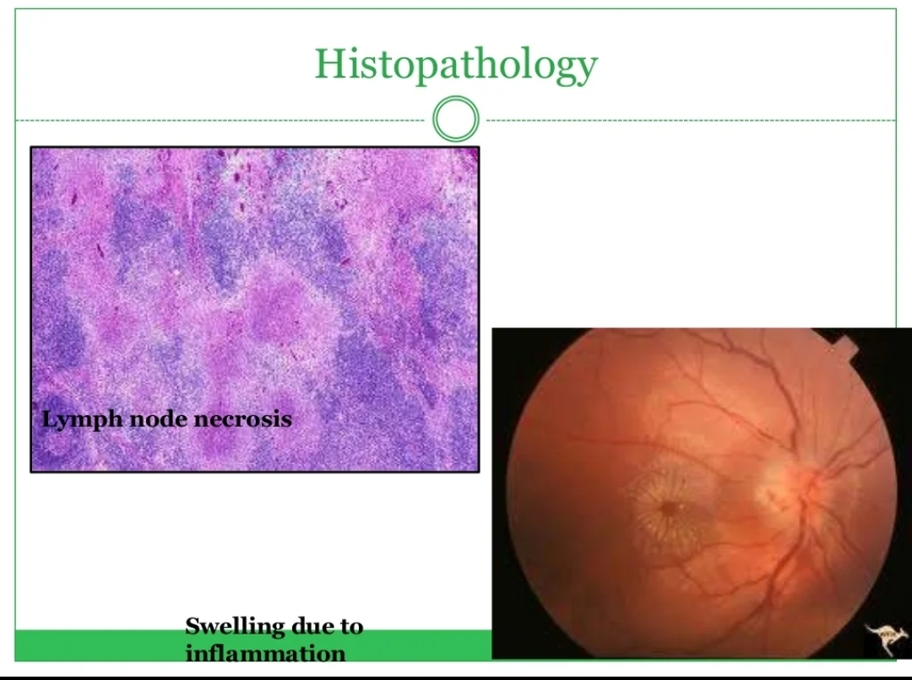

Slide 28
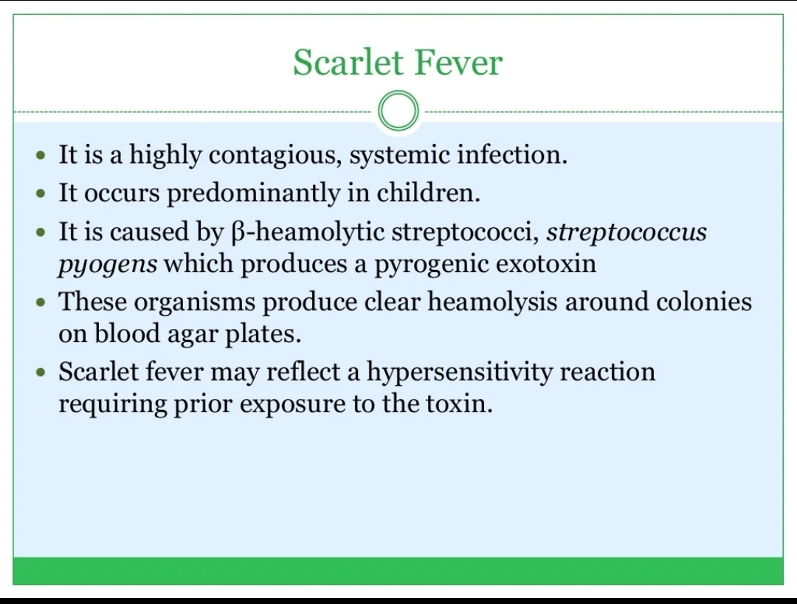

Slide 29
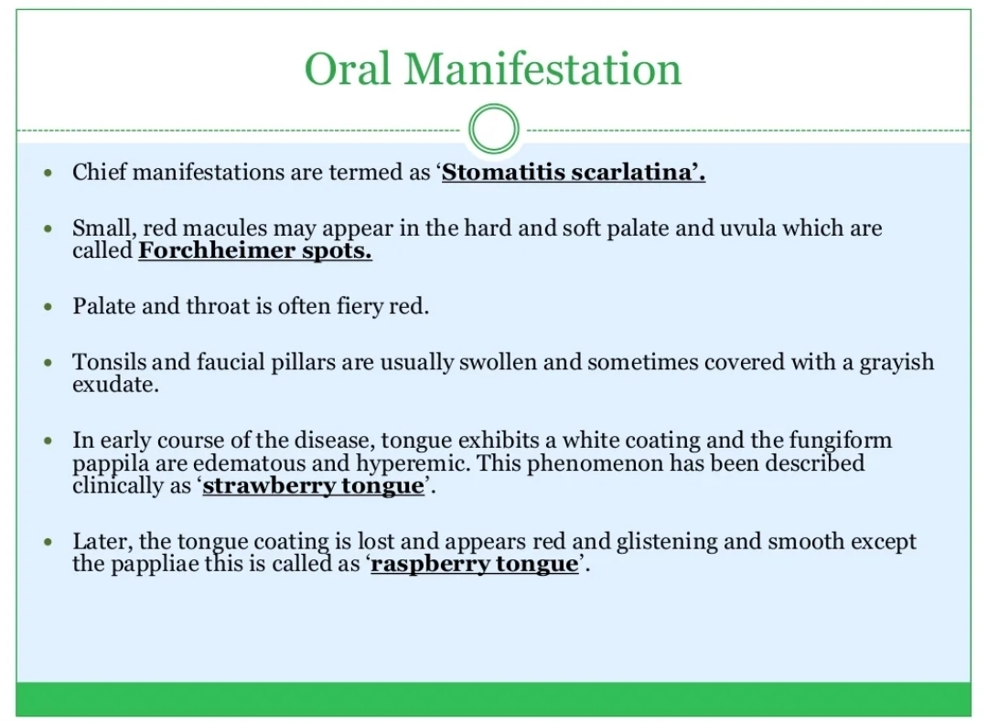

Slide 30
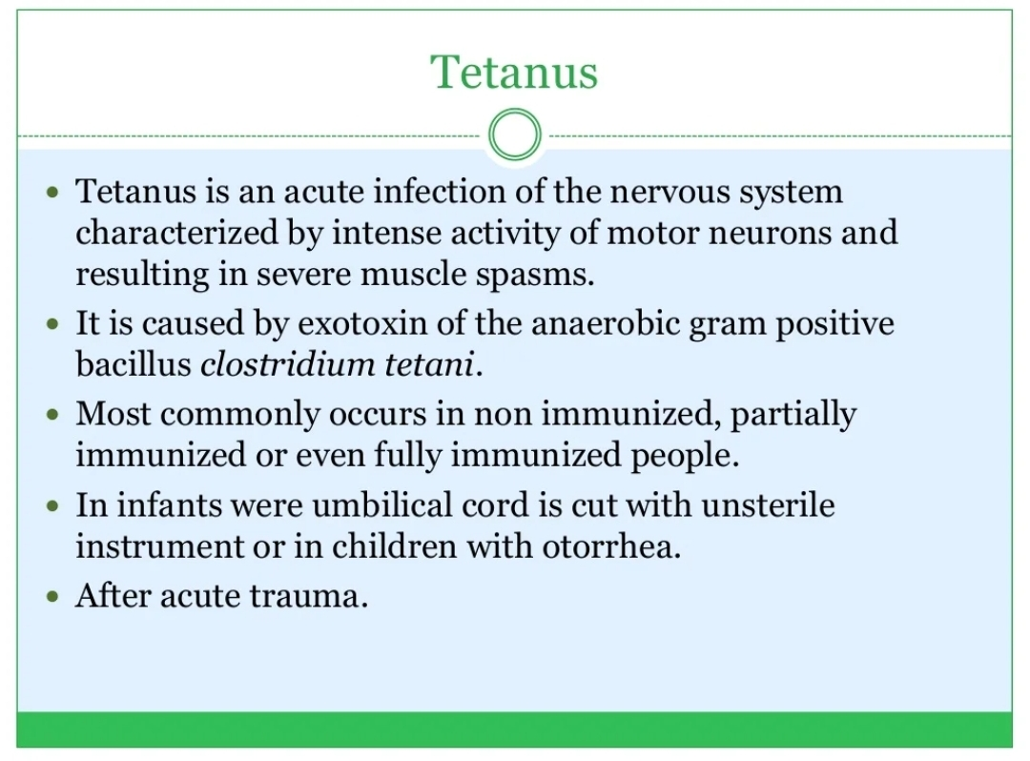

Slide 31
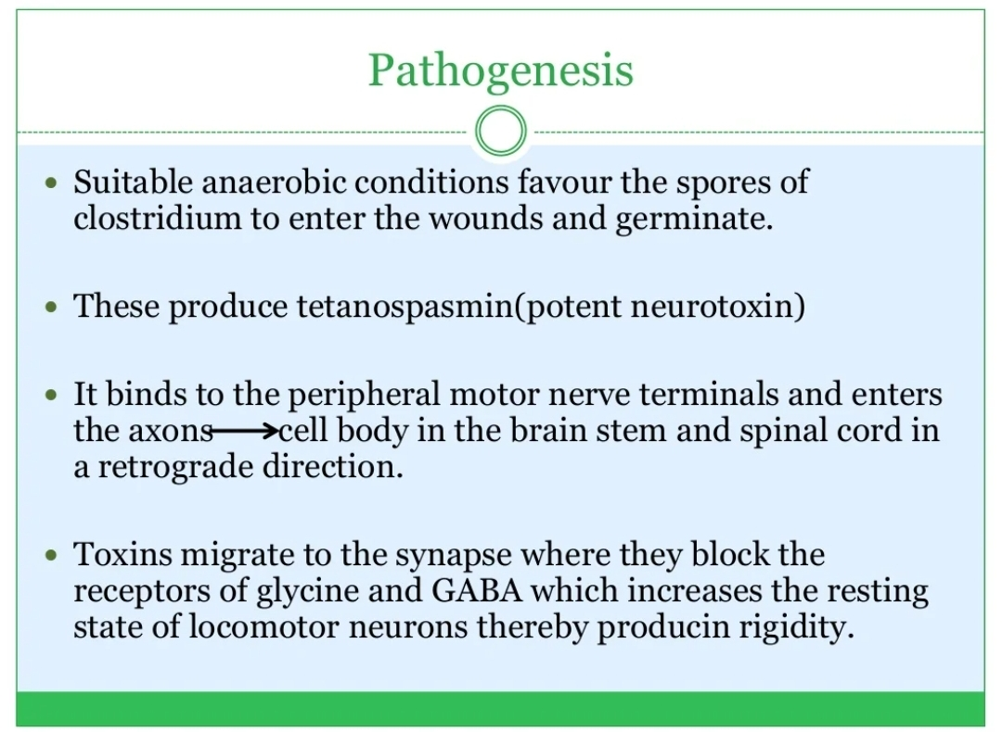

Slide 32
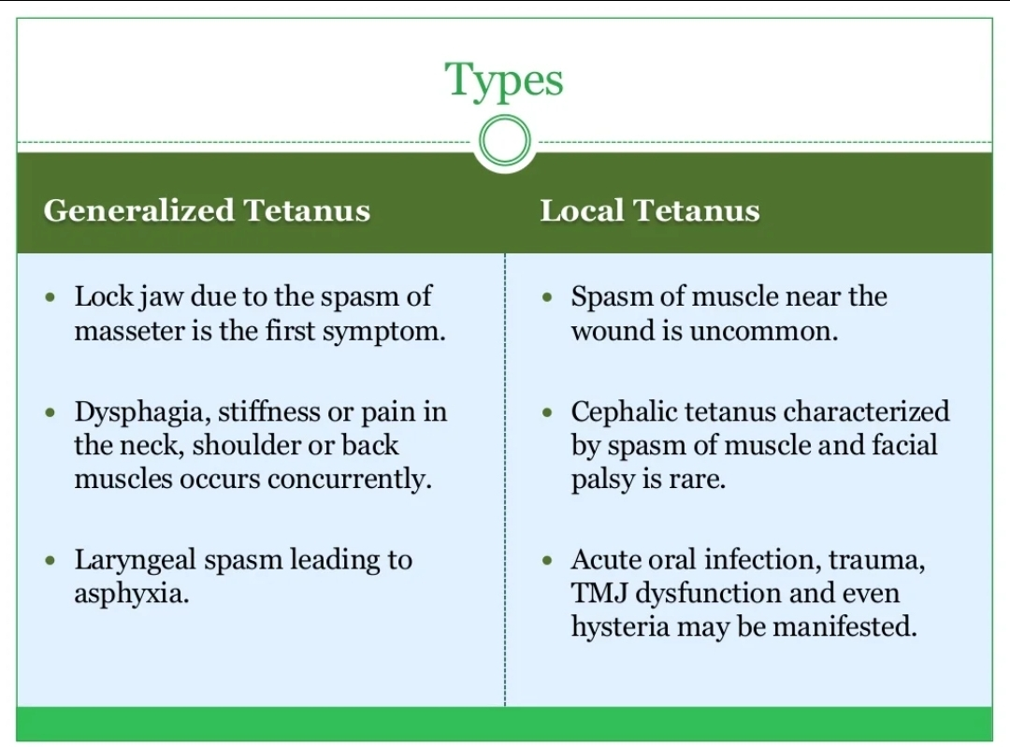

Slide 33
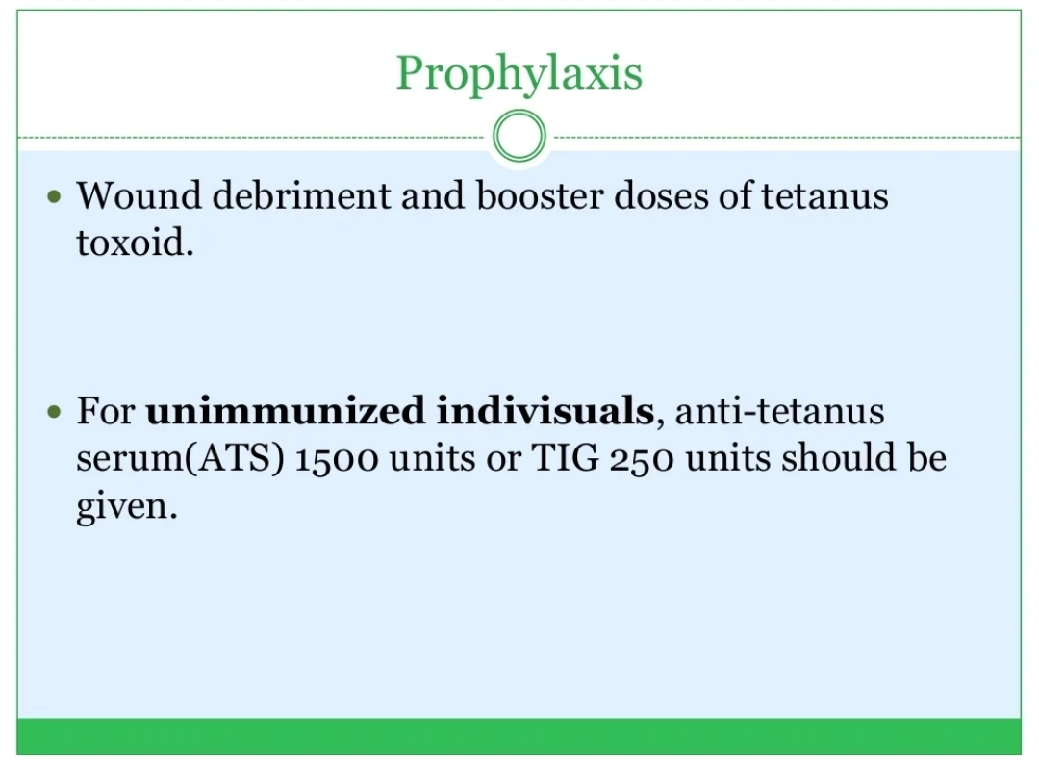

Slide 34
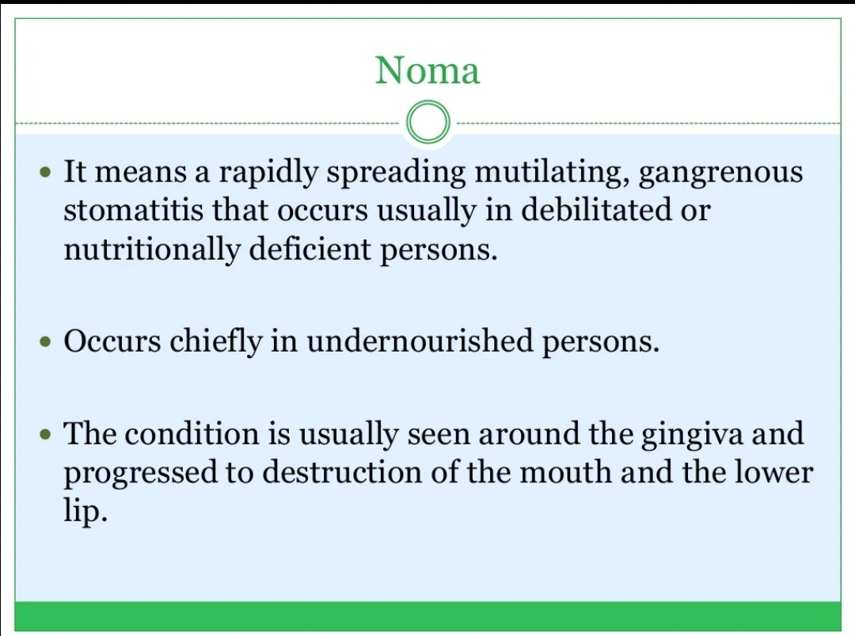

Slide 35
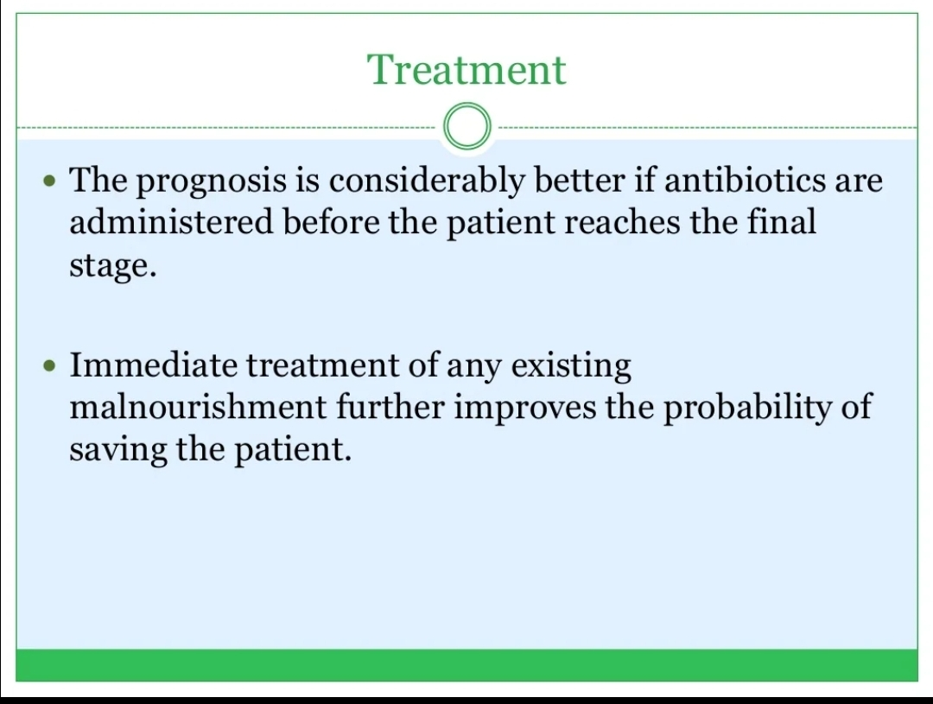

Slide 36
Take home message
Patient with oral mucosal infection frequently present with symptoms of pain ,inflammation and odynophagia to the emergency department
Oral manifestations of bacterial infections are common and most importantly ,they tend to be one of their first clinical signs

Slide 37
Question & Answer Session
TYPES OF LEPROSY
DESCRIBE ABOUT ACTINOMYCOSIS
HUTCHINSON’S TRIAD
ORAL MENIFESTATIONS OF GONORRHOEA
TREATMENT OF TUBERCULOSIS
ORAL MANIFESTATIONS OF SCARLET FEVER
DEFINE NOMA
PATHOGENESIS OF TETANUS

Slide 38
REFERENCES NAME OF THE BOOK WITH EDITION AND PAGE NUMBERS ARTICLE ARE TO BE MENTIONED IF NEEDED
SHAFER’S 9th EDITION
LUCAS
NEVILLE
REGEZI

Slide 39


